Slide 1
Java Plays – Microservices
IBM
Source: Interconnect

Slide 2
What are Microservices?
Application architected as a suite of small services, each running in its own process, and communicating with lightweight mechanisms e.g. REST/HTTP
Services built around business capabilities
Each service independently deployable via automation
Minimal centralised governance May be written in different languages
May use different data storage technologies

Slide 3
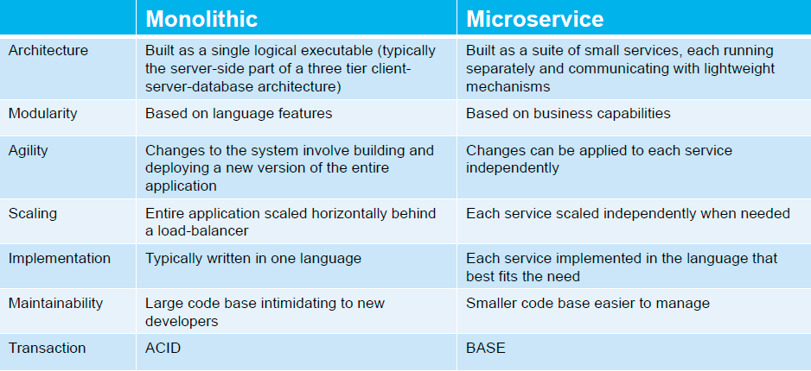
Monolithic vs Microservices

Slide 4
Componentization Via Services
Component is a unit of software that is independently replaceable and upgradeable
Libraries are components that are linked in to a program and called used in-memory function calls
Services are out-of-process components who communicate, for example, via web service requests or RPC
Unlike libraries, services can be independently redeployed
Using a service results in an explicit published interface
Remote calls are more expense leading to coarser-grained APIs
A service may consist of multiple processes e.g. the application process, cache, and associated database

Slide 5
Organized around Business Capabilities
Monolithic project teams are often aligned around technology layers meaning even simple changes involve multiple teams
Any organization that designs a system (defined broadly) will produce a design whose structure is a copy of the organization's communication structure – Melvyn Conway, 1967
Organize services around business capabilities results in cross-functional teams
Typically those teams are small (Amazon “Two pizza team”) but don’t get hung up on the ‘micro’
Strong tie-in to DevOps: each team is responsible for the entire lifecycle of its service

Slide 6
Smart Endpoints and Dumb Pipes
Historically there has been an emphasis on putting intelligence (e.g. routing, transformation and even choreography) in to the communications channel e.g. Enterprise Service Bus
Microservices communicate directly using simple protocols such as REST/HTTP and AMQP
Significant differentiator from what we traditional think of in a SOA architecture
Try to avoid versioning by making services and clients tolerant to changes
API Gateway (used to consolidate multiple client calls) somewhat contrary to this

Slide 7
Decentralization
Decentralized governance
Monoliths tend to standardise on a single technology platform whereas it may be appropriate to use different tools (e.g. languages or databases) for different parts of an application
With microservices, ‘standardisation’ is through sharing of common code/tools
Decentralized data management
Each service owns its own data model and data
Coordination between services must be transaction-less (use eventual consistency and compensation)

Slide 8
Microservice Challenges
Greater operational complexity – more moving parts
Devs need significant ops skills
Service interfaces and versioning
Duplication of effort across service implementations
Additional complexity of creating a distributed system – network latency, fault tolerance, serialization, …
Designing decoupled non-transactional systems is hard
Avoiding latency overhead of large numbers of small service invocations
Locating service instances
Maintaining availability and consistency with partitioned data
End-to-end testing

Slide 9
Developing and Deploying Microservices using Bluemix/CloudFoundry

Slide 10
Reducing Operational Complexity
Platform-as-a-Service exists to remove the complexity of deploying applications – the PaaS provider also handles the complexity of managing and monitoring the infrastructure
Cloud Foundry provides a consistent deployment mechanism regardless of programming language
Buildpacks ensure that applications are kept up-to-date with new versions of the runtime and libraries
Routing and load balancing handled by Cloud Foundry router
Service dependencies are resolved at deployment time
Repeatable deployment through IBM DevOps Services or CLI, Maven/Gradle/Travis/Jenkins plugins (you can even run Jenkins on Cloud Foundry!)
Cloud Foundry V3 API to allow multiple processes per app

Slide 11
Service Discovery
Within a Cloud Foundry environment, routes and the CF router provide all that is needed to locate a service instance Cloud Controller manages distribution and availability of application instances
Blue-green deployments supported by binding multiple application versions to the same route
cf cups (create user provided service) provides a convenient mechanism to inform one microservice of the route for a microservice on which it is dependent
Where instances of a microservice are deployed to multiple Cloud Foundry environments, consider using a runtime registry e.g. Eureka or highly-available data store e.g. etcd or Zookeeper

Slide 12
Configuration
The same application should be deployable in to multiple environments – don’t build configuration in to the application
Environment variables are a simple mechanism portable across most runtimes and cloud and non-cloud environments Cloud Foundry provides the ability to set environment variables in the manifest at push time or subsequently via cf set-env
Netflix Archaius provides a mechanism to poll a hierarchy of configuration sources Property files and URLs out of the box but other configuration sources are pluggable

Slide 13
Design For Failure
Any service call could fail where failure could be anything from an immediate error code to never returning – need to handle that gracefully
Emphasis on real-time monitoring of technical and business metrics
Application monitoring through Monitoring and Analytics service or third-party service e.g. New Relic
Gives insights which might not be uncovered in a monolithic application
Implement patterns from ‘Release It!’ e.g. via Netflix Hystrix Circuit Breaker
protect from downstream failures
Bulkhead – limit resources that can be consumed
Timeout

Slide 14
Communication Protocols
Cloud Foundry currently only supports inbound HTTP Web sockets is an option in preference to long polling
JSON may be the best fit for client facing services but consider other options such as Apache Thrift or Google Protocol Buffers where serialization efficiency is important
Typically start with synchronous protocols and add asynchronous (e.g. via MQ Light) where needed to support the interaction style or performance goals
Parallel invocation of downstream services may be required to ensure responsiveness is maintained
Consider using a reactive programming model (e.g. RxJava) or Java 8’s CompletableFuture

Slide 15
Securing Microservices
Cloud Foundry applications are all public facing (Application Security Groups introduced in the CF 1.3 release relate to outbound traffic)
Normal rules apply e.g. basic authentication and authorisation as a starting point
Bluemix Single Sign On service provides a simple mechanism to use an existing identity source or Bluemix based user registry for SSO

Slide 16
Microservices Example
Alchemy API
Find Author of the Article Application
Java UI
MQLight
Find Author Microservice
Jazzhub link →
https://hub.jazz.net/git/ecosysdevcnc/javaplays-microservice/

Slide 17
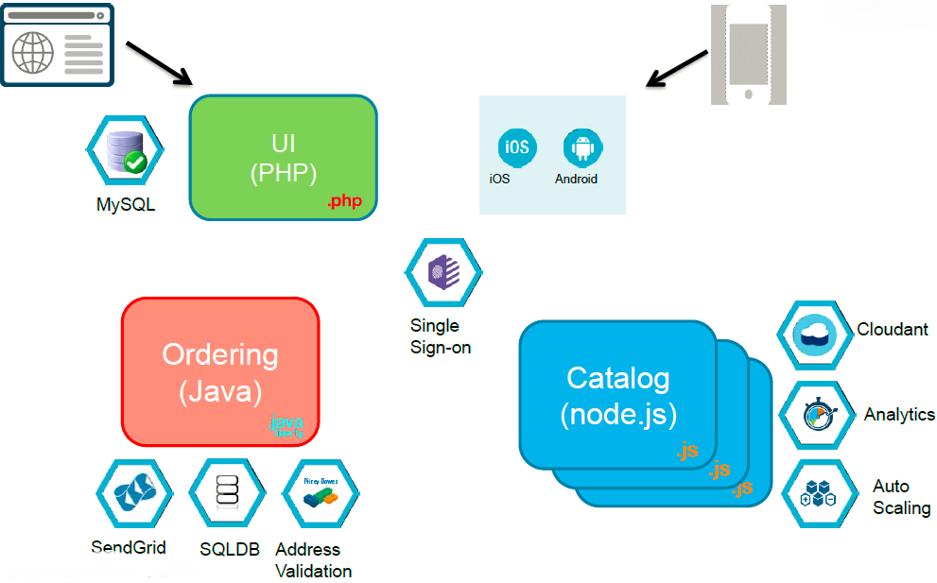
Microservices Example

Slide 18
Questions?

